Slide 1
CSE 464 : Software Quality Assurance and Testing
Testing Object Oriented Applications Janaka Balasooriya

Slide 2
UML Support for Integration Testing
In OO integration testing, sequence diagrams and collaboration diagrams are the basic for integration testing
Quick Review Sequence Diagram:
  Sequence diagrams describes the dynamic behavior of objects
  It describes interactions between objects by depicting the time ordering. In general each use case has one of more sequence diagrams.

Slide 3
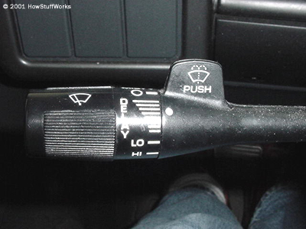
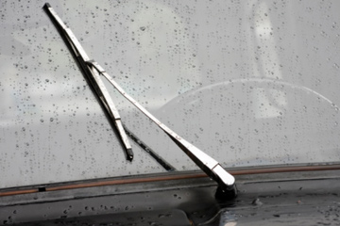
Windshield Wiper Example
auto.howstuffworks.com

Slide 4
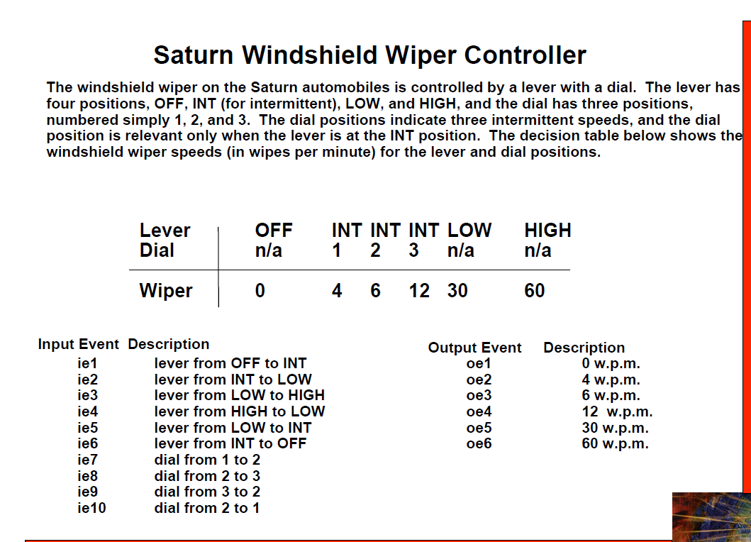

Slide 5
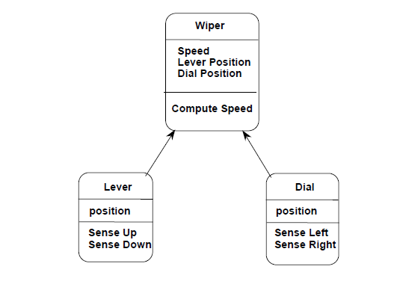
Windshield Wiper Objects

Slide 6
Windshield Wiper System Implementation

Slide 7
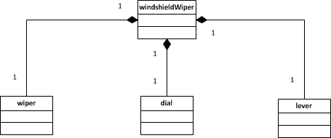
Implementation : Objects
See implementation posted in the class website

Slide 8
Testing the Windshield Wiper Application
Uisng JUnit
JUnit test cases that test get-set methods
JUnit test cases based on its usage – use case based
JUnit test cases based on state chart

Slide 9
Get-set test cases - Demo

